Slide 1
Web Development Internship
PICT FOSS Club
PICT TnP Platform
-By Vinayak Jamadar

Slide 2
Problem Statement
The project was to develop a PICT TnP Platform, which aimed to streamline the recruitment process for the institute. This application will help PICT TnP Cell for generating custom reports of students in the placement.

Slide 3
INTRODUCTION
This presentation documents my internship experience at the TnP cell of my college, where I worked on developing a website to streamline the recruitment process and generate custom reports of students in the placement process. In this report, I will describe the problem the website aims to solve, the technologies and tools I used to develop it, and the impact it has had on the recruitment process and TnP cell.

Slide 4
OBJECTIVES OF INTERNSHIP
To gain hands-on experience in developing a real-world application using Node.js, MongoDB, Express.js, and React.js.
To understand the recruitment process of our institute and identify opportunities to streamline it using technology.
To develop skills in agile software development, including requirements gathering, design, coding, testing, and deployment.
To improve teamwork and communication skills by collaborating with other developers, designers, and stakeholders on the project.
To learn how to gather and analyse user feedback and incorporate it into the development process.
To gain insights into the workings of a professional environment and the role of technology in solving real-world problems.

Slide 5
SCOPE OF STUDY
The scope is limited to the website developed during my internship for TnP Cell, which aims to streamline the recruitment process of our institute and generate custom reports for the TnP cell.
It does not cover any other projects or activities that I was involved in during my internship at the FOSS Club.

Slide 6
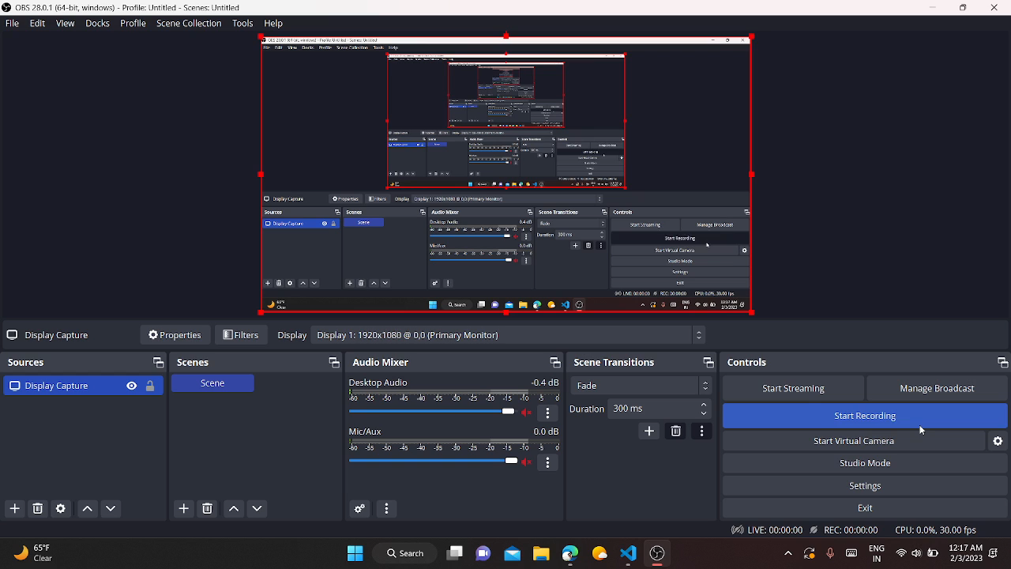

Slide 7
METHODOLOGICAL DETAILS
The methodology adopted for designing the TnP website involved the following steps:
Understanding the client's requirements (TnP Cell)
Conducting research on how the recruitment process works.
Designing the website layout using Adobe XD
Coding the website using ReactJS, Nodejs, ExpressJS, etc.
Testing the website for bugs and errors
Deploying the website on a web server

Slide 8
METHODOLOGICAL DETAILS
Understanding the client's requirements (Tnp Cell):
The methodology began with a thorough understanding of the requirements set forth by the Tnp cell. This involved regular meetings and discussions with the client to gain insights into their needs, expectations, and goals for the website. By actively listening to the client's inputs and clarifying any ambiguities, we ensured that the website would effectively address their specific requirements and streamline the recruitment process.

Slide 9
METHODOLOGICAL DETAILS
2. Conducting research on how the recruitment process works:
To create a website that effectively streamlined the recruitment process, extensive research was conducted to gain a comprehensive understanding of the existing procedures and pain points. This involved studying the various stages of the recruitment process, such as job posting, applicant tracking, interview scheduling, and final placement decisions. The research findings played a crucial role in identifying opportunities for improvement and informed the subsequent design and development phases.
3.Designing the website layout using Adobe XD:
The design phase involved using Adobe XD, a powerful prototyping tool, to create the website layout. This step included visualizing the user interface, designing intuitive navigation flows, and ensuring a user-friendly experience. By collaboratively working with the Tnp cell and incorporating their feedback, the website's design was refined and aligned with their branding guidelines, resulting in a visually appealing and cohesive user interface.

Slide 10
METHODOLOGICAL DETAILS
4. Coding the website using ReactJS, Nodejs, ExpressJs, etc.:
The coding phase revolved around implementing the website's functionalities using a combination of technologies such as ReactJS, Node.js, Express.js, and other relevant tools and frameworks. Leveraging the power of ReactJS for frontend development and Node.js for backend, we built robust and scalable components that facilitated efficient data management, seamless user interactions, and integration with the backend database. By following best practices and adhering to coding standards, we ensured a well-structured and maintainable codebase.

Slide 11
METHODOLOGICAL DETAILS
ReactJS:
ReactJS is a popular open-source JavaScript library used for building dynamic user interfaces.
It provides a component-based approach to UI development, enabling easy reusability and maintenance.
ReactJS uses a virtual DOM, allowing for efficient and faster rendering of components.
It provides tools for managing state and handling events, making it easier to create complex UI interactions.
ReactJS has a vast and active community, with a plethora of resources and libraries available for developers.

Slide 12
METHODOLOGICAL DETAILS
ExpressJS:
ExpressJS is a popular open-source web application framework for Node.js.
It provides a minimalist and flexible approach to building web applications and APIs.
ExpressJS offers robust routing capabilities, making it easy to define API endpoints and handle HTTP requests.
It provides middleware functions for handling common tasks such as authentication, logging, and error handling.
ExpressJS has a low learning curve, making it accessible for developers of all skill levels.

Slide 13
METHODOLOGICAL DETAILS
MongoDB:
MongoDB is a popular open-source NoSQL database used for storing and retrieving large volumes of unstructured data.
It provides a document-oriented data model, allowing for easy scalability and flexibility.
MongoDB supports a wide range of data types and supports rich queries, making it easy to retrieve data based on various criteria.
It offers features such as automatic sharding, replication, and load balancing, ensuring high availability and fault tolerance.

Slide 14
METHODOLOGICAL DETAILS
5. Testing the website for bugs and errors:
Thorough testing was an integral part of the methodology to ensure the website's functionality, reliability, and performance. Rigorous testing processes, including unit testing, integration testing, and user acceptance testing, were carried out to identify and rectify any bugs, errors, or inconsistencies in the website. By conducting both manual and automated testing, we aimed to deliver a high-quality website that met the client's requirements and provided a seamless user experience.

Slide 15
OUTCOMES OF INTERNSHIP
The outcomes of my internship were:
Improved technical skills: Through our work on the TnP website, we likely gained hands-on experience with various technologies such as ReactJS, NodeJS, and MongoDB. This experience likely helped us improve our technical skills and knowledge of web development.
Real-world project experience: Developing a website for a real client likely exposed us to a range of challenges and obstacles that are not present in tutorial projects. This experience could help us stand out to potential employers in the future.
Improved collaboration and communication skills: Working in a team with the TnP Cell likely required us to communicate effectively, collaborate with others, and manage our time efficiently.
Positive impact on TnP Cell operations: By developing a website to streamline recruitment processes and generate custom reports, you likely had a positive impact on the efficiency of the TnP Cell.

Slide 16
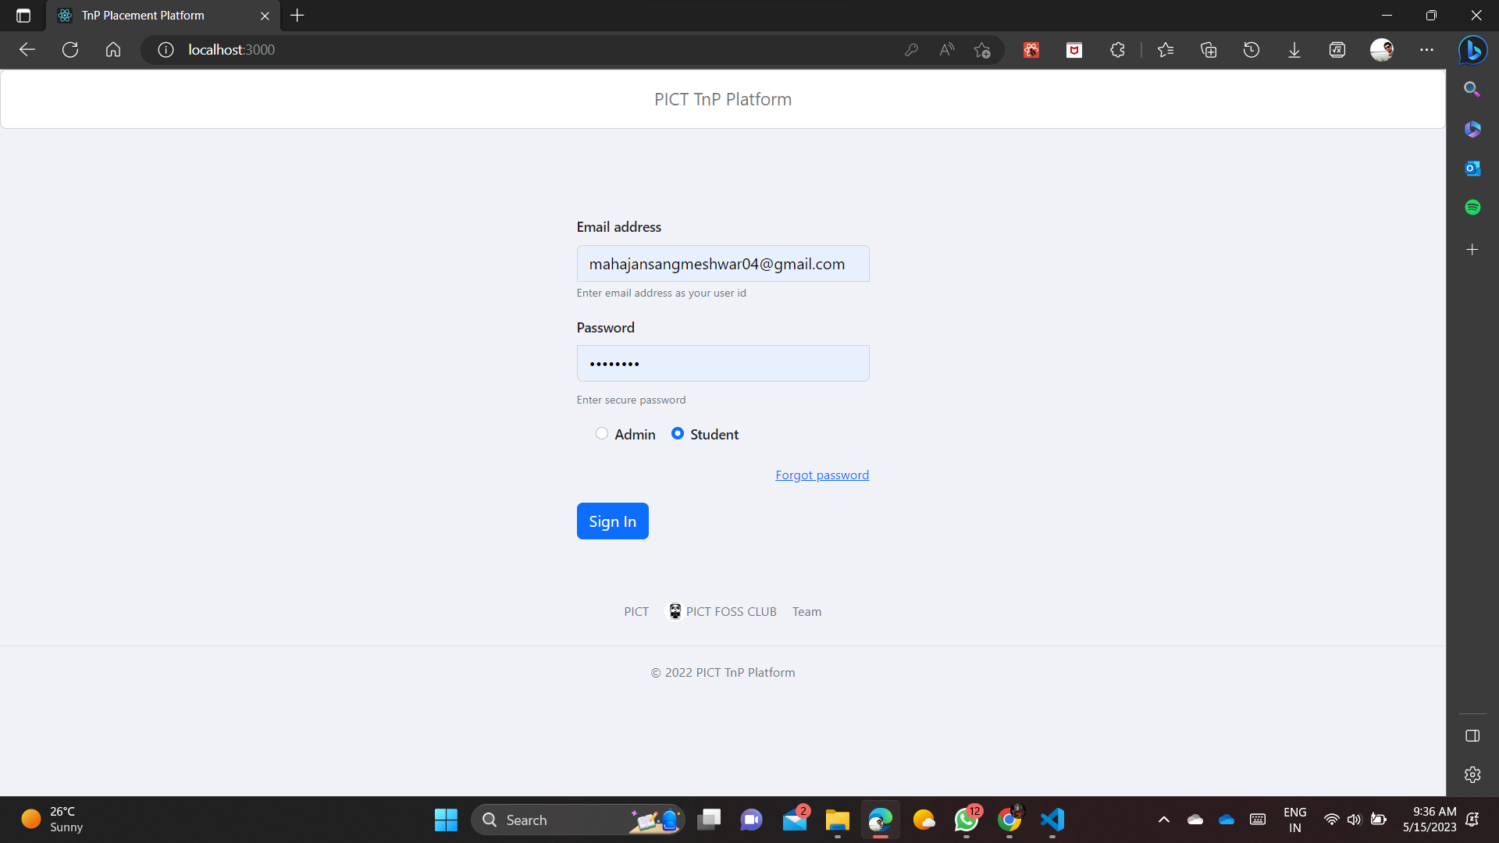

Slide 17
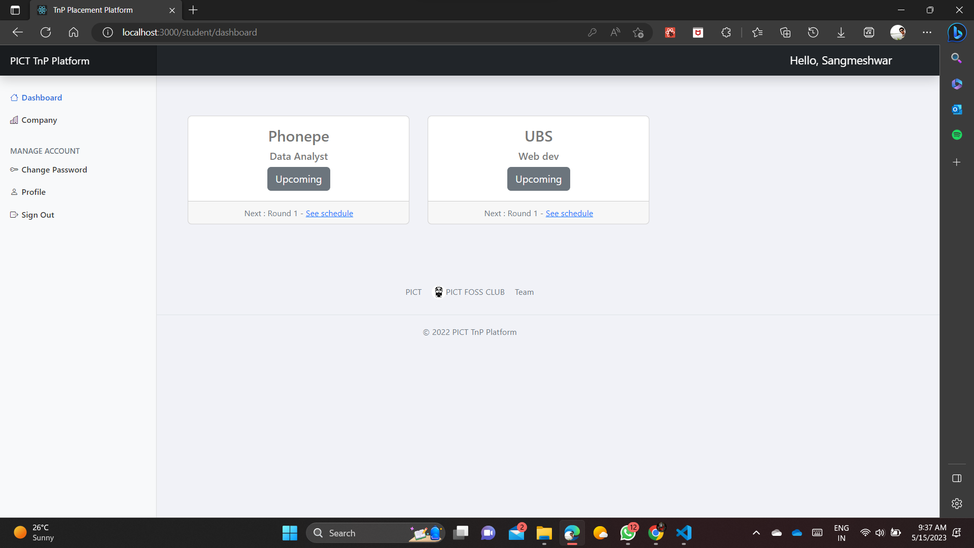
My Work

Slide 18
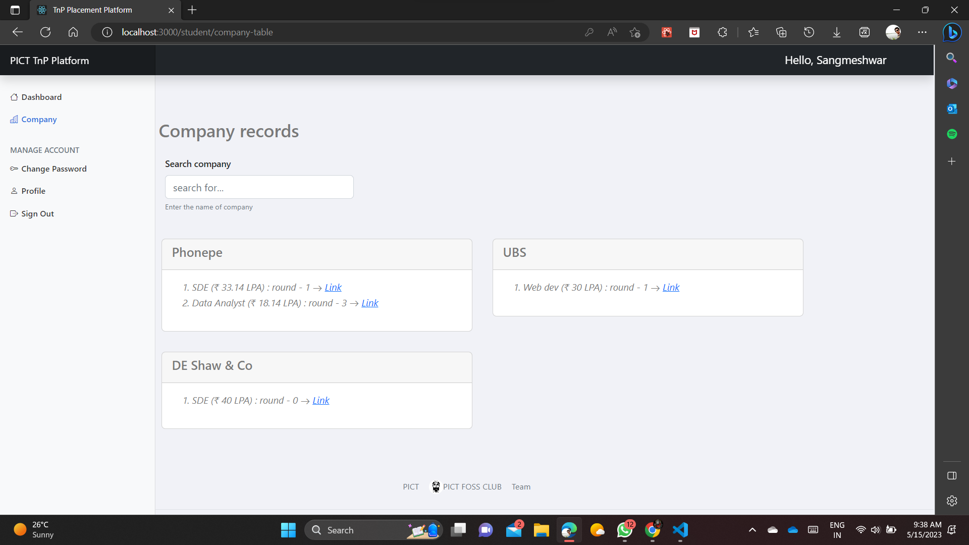
My Work

Slide 19
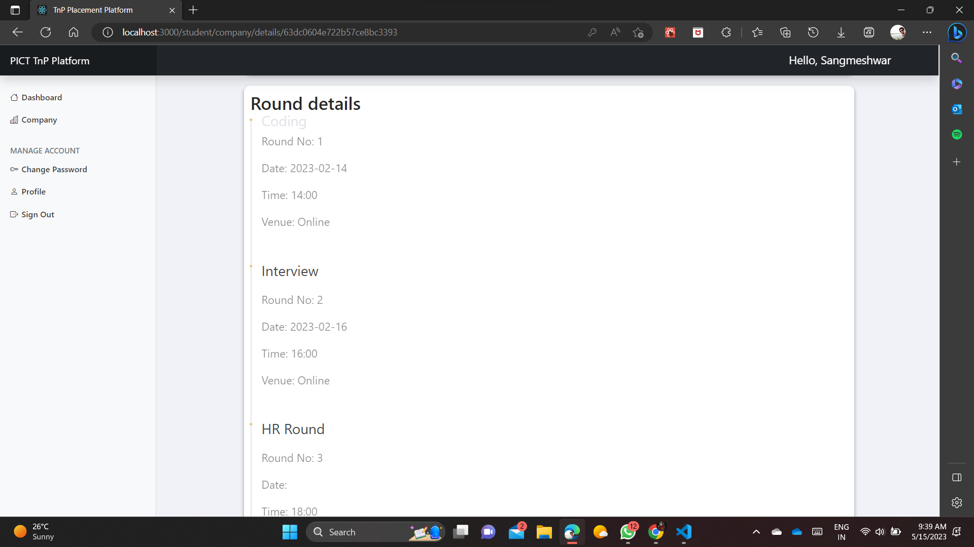

Slide 20
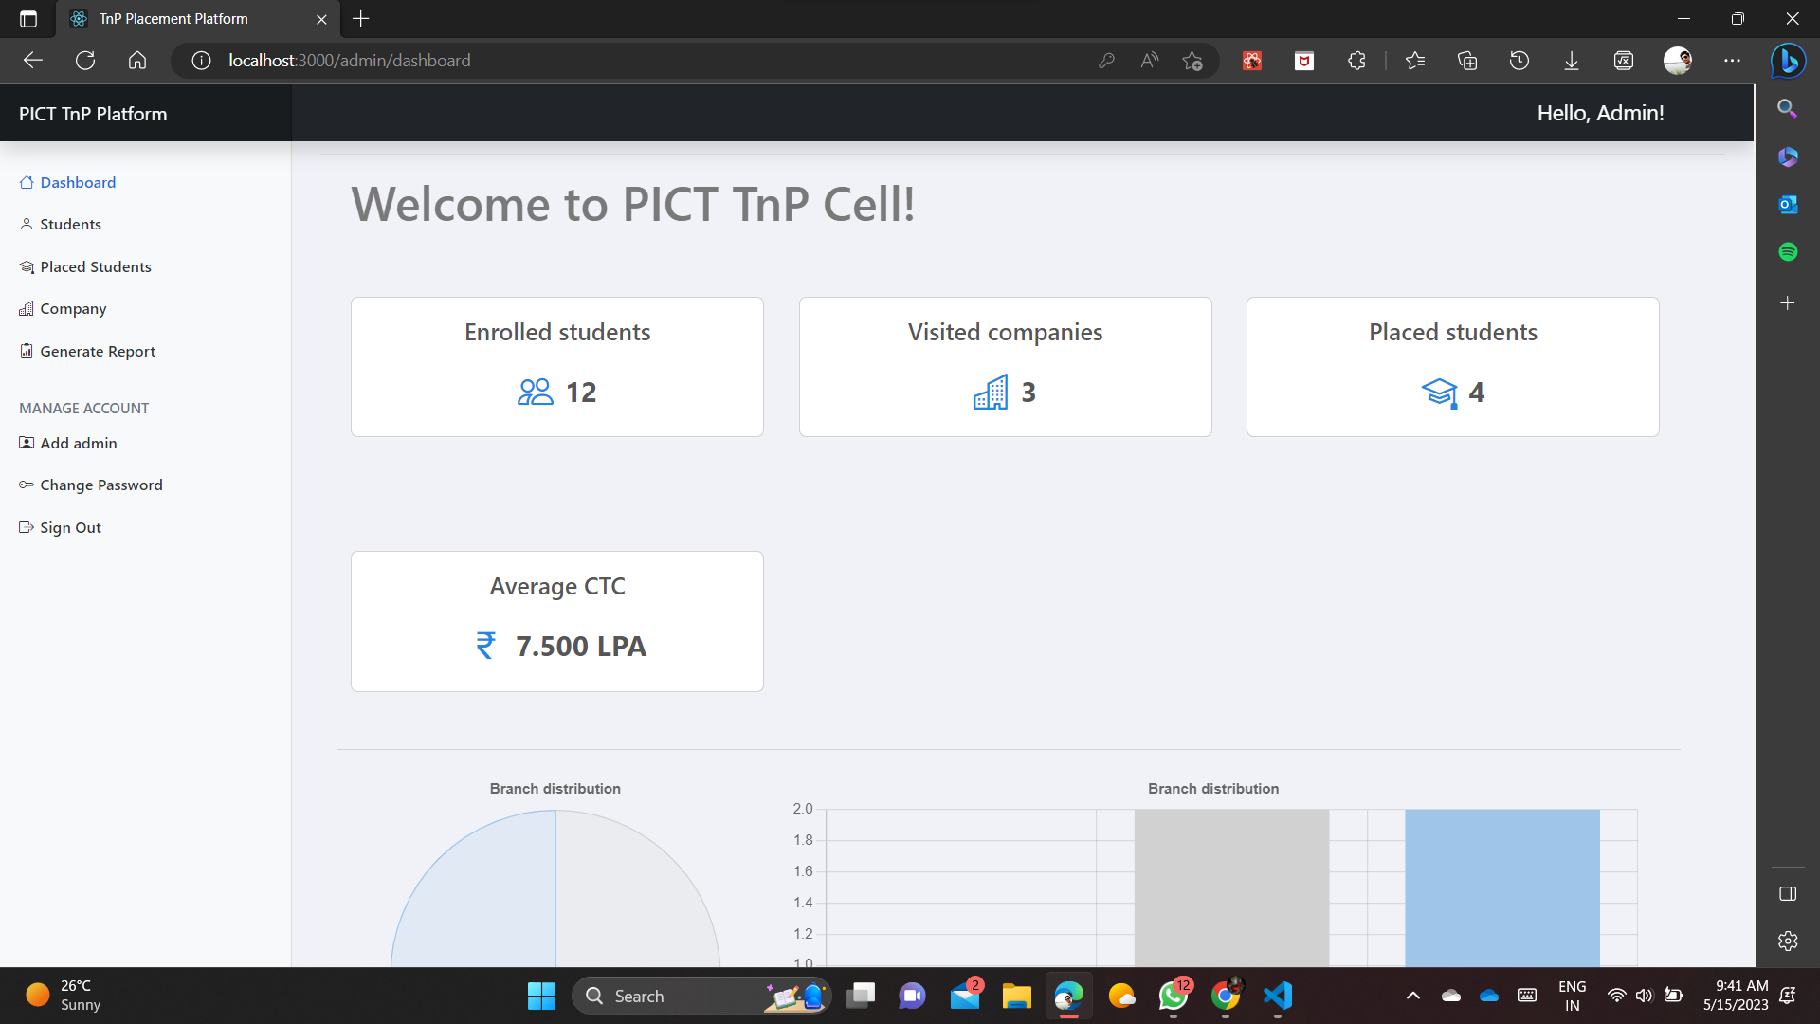

Slide 21
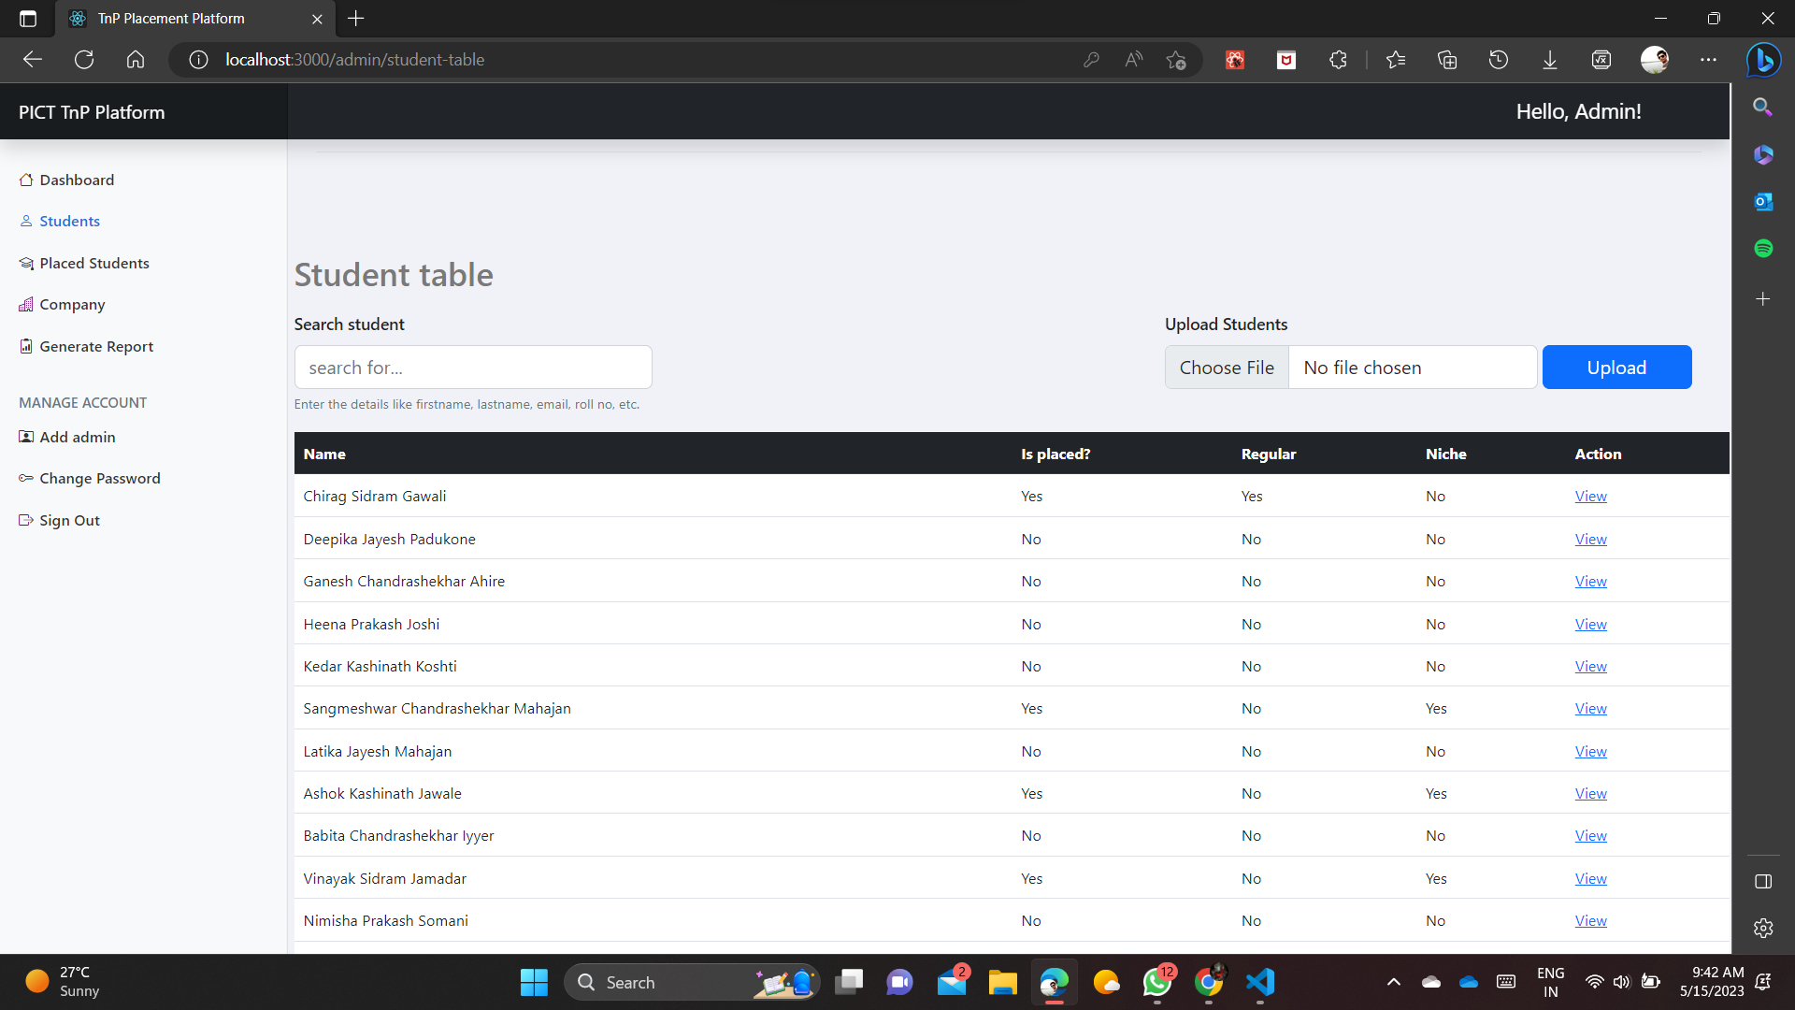

Slide 22
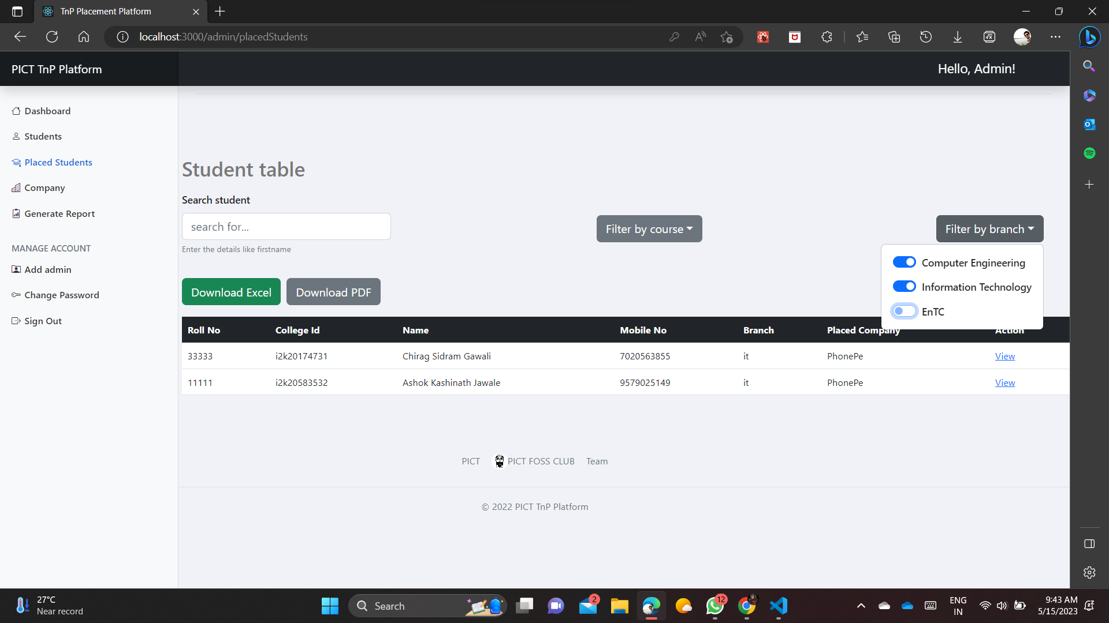

Slide 23
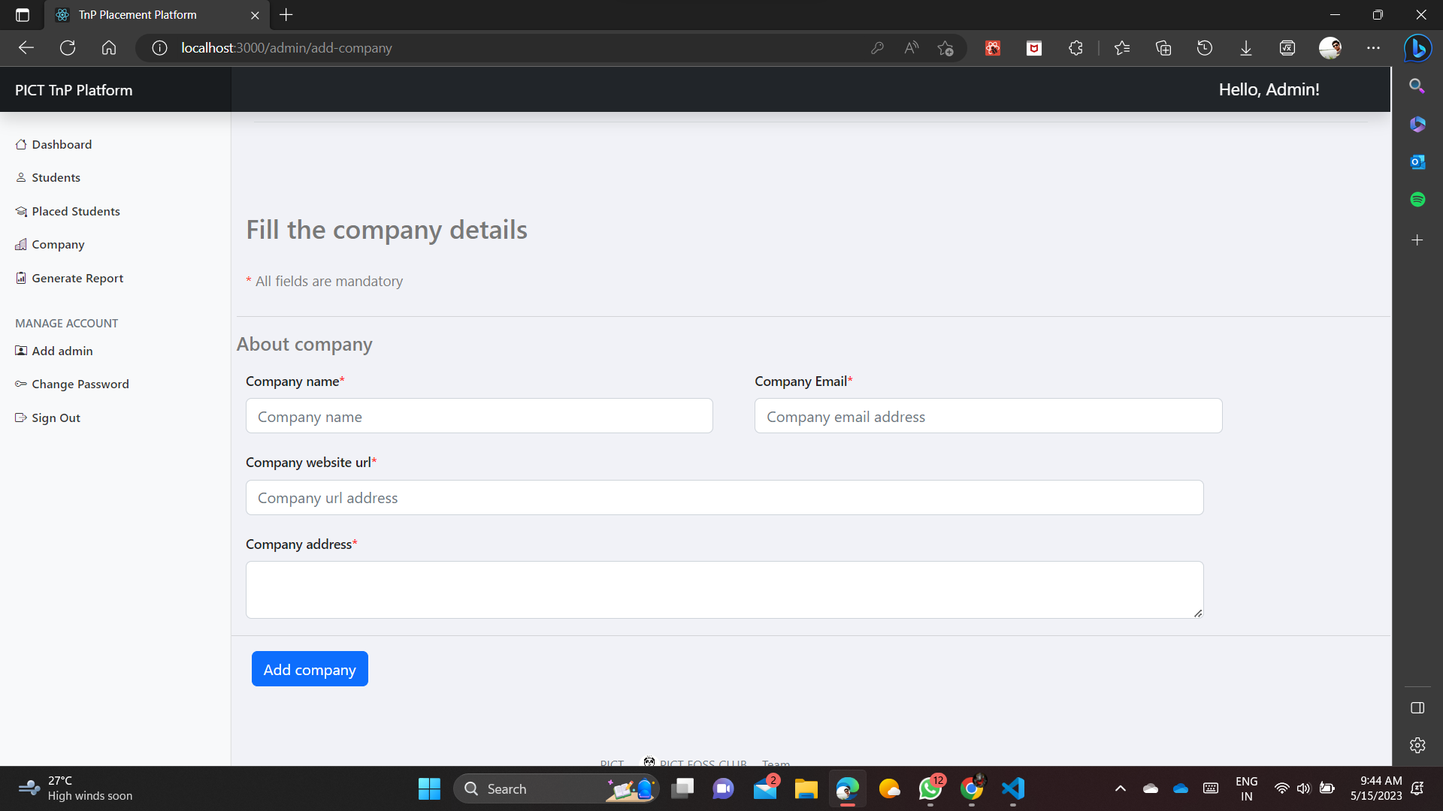

Slide 24
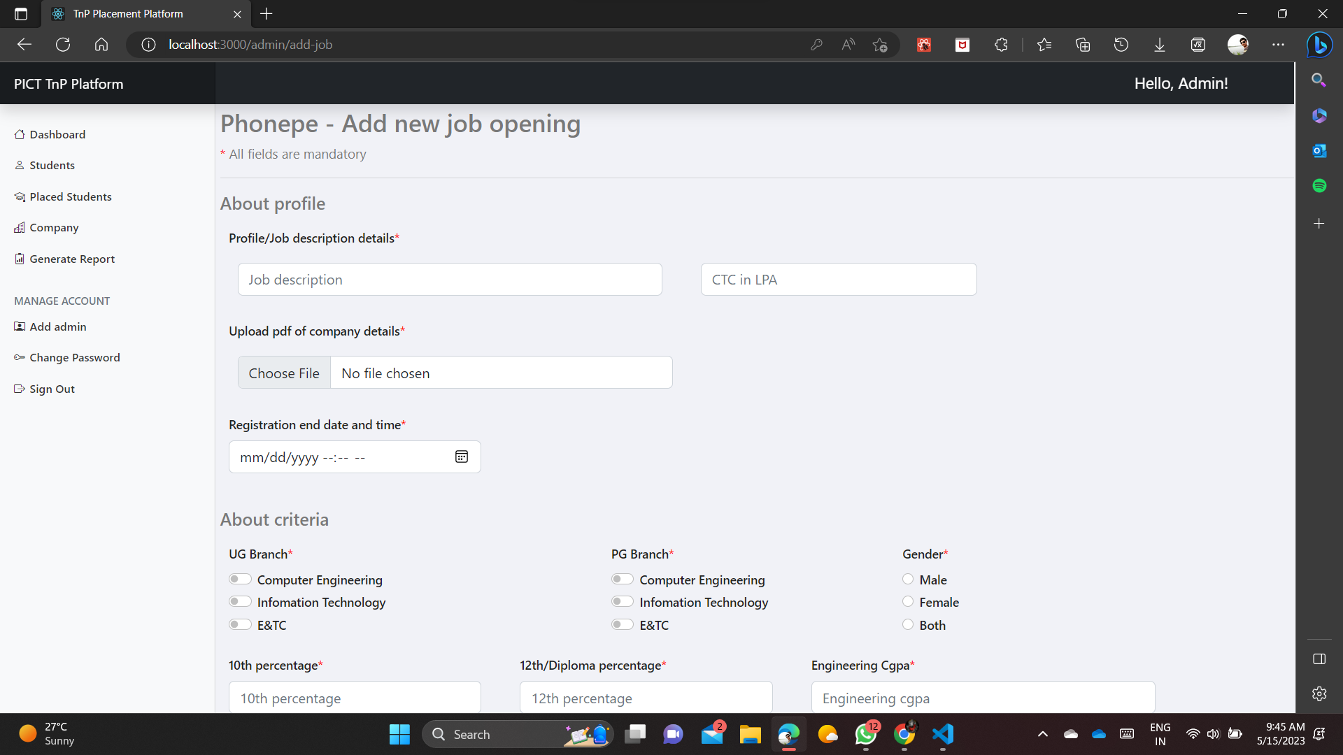

Slide 25
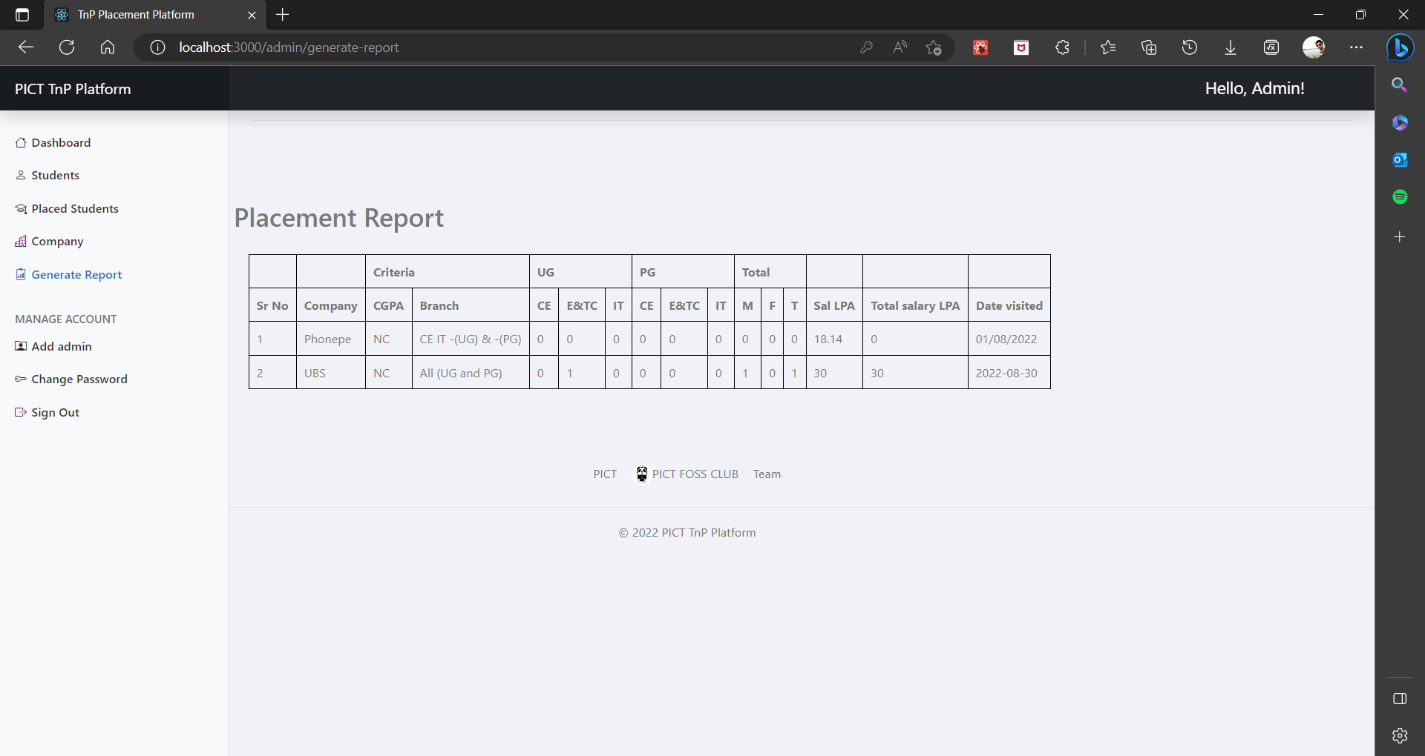

Slide 26
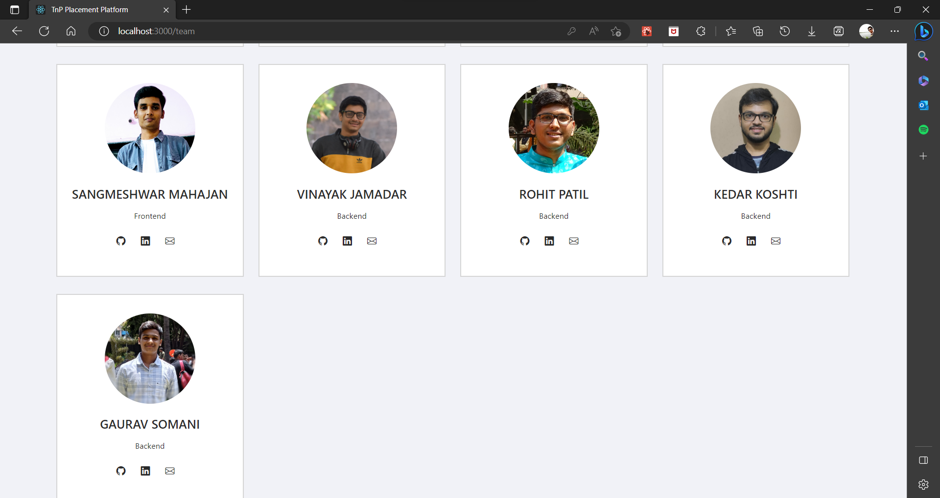

Slide 27
CONCLUSION
In conclusion, this internship provided valuable experience in web development, project management, and collaboration. By working closely with the TnP Cell, we gained a deeper understanding of the recruitment process and how technology can be used to streamline operations.
Our work on the TnP website likely had a positive impact on the efficiency of the TnP Cell and could lead to better outcomes for students and the institute. Overall, this internship helped us develop important technical and soft skills that will be useful in our future career endeavours.

Slide 28
THANK YOU

